Slide 1
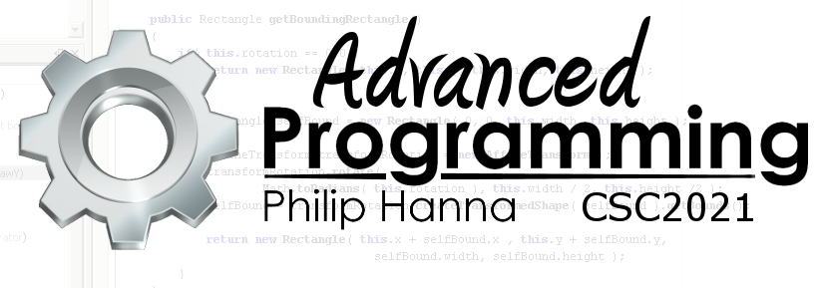
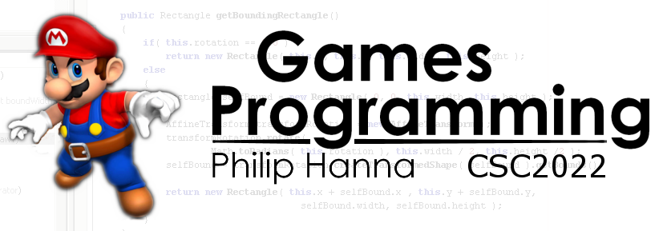
Data in Memory
How data is stored in memory
Part 1 - Introduction

Slide 2

Memory

Slide 3
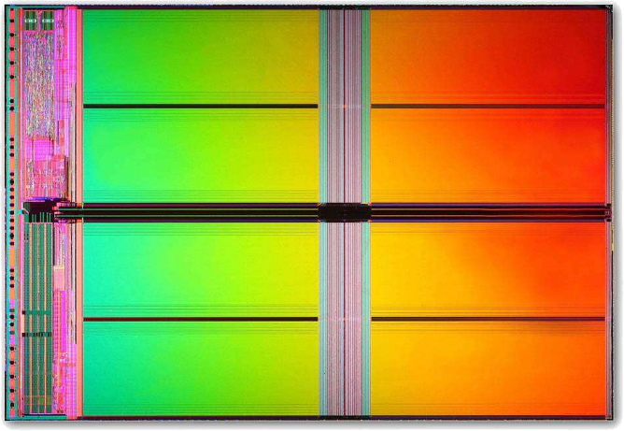
Memory is organised into numbered locations called bytes. Each byte of memory has an address (determining its ‘position’ within memory).
Primitive data are stored in one or more consecutive bytes of memory at a defined address. The number of bytes depend upon the type of variable.
The location of the first stored byte (address) and the number of bytes used to hold the variable (size) are frequently used in C++.
Notes:
Memory within a computer is organised into a large number of numbered locations. In particular, each byte of memory has an assigned address (uniquely determining its ‘position’ within memory).
All primitive data variables are stored in a defined portion of memory and consists of one or more consecutive bytes of memory. The number of bytes is determined by the defined type of the variable.
In C++ the location of the first stored byte for the variable (address) and the number of bytes used to hold that variable (size) can be retrieved and are often used.

Slide 4
Reserve 4-bytes for counter
1 | int counter;
2 | double total;
Direct access to counter at this location
Reserve 8-bytes for total
Direct access to total at this location
0x??01 | 0x??02 | 0x??03 | 0x??04 | 0x??05 | 0x??06 | 0x??07 | 0x??08 | 0x??09 | 0x??0A | 0x??0B | 0x??0C | 0x??0D | 0x??0E | 0x??0F | 0x??10
00 | 00 | 00 | 00 | 00 | 00 | 00 | 00 | 00 | 00 | 00 | 00 | 00 | 00 | 00 | 00
An example of memory allocation and access for two variables is shown above.
Notes:
Memory within a computer is organised into a large number of numbered locations. In particular, each byte of memory has an assigned address (uniquely determining its ‘position’ within memory).
All primitive data variables are stored in a defined portion of memory and consists of one or more consecutive bytes of memory. The number of bytes is determined by the defined type of the variable.
In C++ the location of the first stored byte for the variable (address) and the number of bytes used to hold that variable (size) can be retrieved and are often used.

Slide 5

Variables can be viewed as having type and location. Modifying a variable modifies the memory pointed to by that variable.
Being able to clearly visualize how data is stored and manipulated in memory is key to mastering C++
Notes:
A variable can really be thought of as having a type and a location. Accessing or modifying a variable simply results in access or modify to the chunk of memory pointed to by the variable.
Important: Being able to clearly visualize how data is stored in memory within your programs will really help you master C++

Slide 6

Arrays in Memory

Slide 7
Whenever an array of some type is created, e.g. int data[4], the compiler will reserve enough memory to hold all the specified variables (in this example, a total of 16 bytes, 4x4, will be reserved for and assigned to the array). Important: The entire array is reserved as a single contiguous chunk of memory.
1 | int data[4];
2
Direct access to data[0] to this location
Location of data[1]
Location of data[2]
Location of data[3]
0x??01 | 0x??02 | 0x??03 | 0x??04 | 0x??05 | 0x??06 | 0x??07 | 0x??08 | 0x??09 | 0x??0A | 0x??0B | 0x??0C | 0x??0D | 0x??0E | 0x??0F | 0x??10
00 | 00 | 00 | 00 | 00 | 00 | 00 | 00 | 00 | 00 | 00 | 00 | 00 | 00 | 00 | 00
Notes:
Whenever an array of some type is created, e.g. int vars[10], the compiler will reserve enough memory to hold all the specified variables (in this example, a total of 40 bytes, 10x4, will be reserved for and assigned to the array).
Importantly, the entire array is reserved as a single contiguous chunk of memory.

Slide 8
Array element data type
Number of array elements
Size of each array element
When an array is created, the computer simply records the following information:
When your program accesses an array element, the computer calculates the address as follows:
Address of the first element + (specified array index * size of each array element)
1 | int data[4];
2 | data[2] = 1;
Calculate the address by adding 2 * sizeof(int) to the address of data[0]
Location of data[0]
Location of data[2]
0x??01 | 0x??02 | 0x??03 | 0x??04 | 0x??05 | 0x??06 | 0x??07 | 0x??08 | 0x??09 | 0x??0A | 0x??0B | 0x??0C | 0x??0D | 0x??0E | 0x??0F | 0x??10
00 | 00 | 00 | 00 | 00 | 00 | 00 | 00 | 00 | 00 | 00 | 00 | 00 | 00 | 00 | 00

Slide 9
Address | Value | Index
0x??01 | 00 | dat[0][0]
0x??02 | 00 | dat[0][1]
0x??03 | 00 | dat[0][2]
0x??04 | 00 | dat[0][3]
0x??05 | 00 | dat[1][0]
0x??06 | 00 | dat[1][1]
0x??07 | 00 | dat[1][2]
0x??08 | 00 | dat[1][3]
0x??09 | 00 | dat[2][0]
0x??0A | 00 | dat[2][1]
0x??0B | 00 | dat[2][2]
0x??0C | 00 | dat[2][3]
Multidimensional arrays use multiple indices to index values (with one index per dimension).
As addresses are sequential (i.e. one dimensional) multidimensional arrays are stored like a one dimensional array.
1 | char dat[3][4];
2
Notes:
Multidimensional arrays use multiple indices to index values (with one index per dimension).
As addresses are sequential (i.e. one dimensional) multidimensional arrays are store like a one dimensional array.

Slide 10
Address | Value | Index
0x??01 | 00 | dat[0][0]
0x??02 | 00 | dat[0][1]
0x??03 | 00 | dat[0][2]
0x??04 | 00 | dat[0][3]
0x??05 | 00 | dat[1][0]
0x??06 | 00 | dat[1][1]
0x??07 | 00 | dat[1][2]
0x??08 | 00 | dat[1][3]
0x??09 | 00 | dat[2][0]
0x??0A | 00 | dat[2][1]
0x??0B | 00 | dat[2][2]
0x??0C | 00 | dat[2][3]
To access a value in a multidimensional array, each higher order index accesses a subarray within the overall array. Lower order indices specify a location within the subarray.
How arrays are structured in memory will be of importance whenever pointers are considered.
Location of dat[0]
Location of dat[1]
Location of dat[2]
1 | char dat[3][4];
2
Notes:
To access a value in a multidimensional array each higher order index accesses a subarray within the multidimensional array (as shown). Lower order indices specify a location within the subarray.
How arrays are structured in memory will be of importance whenever pointers are considered.

Slide 11
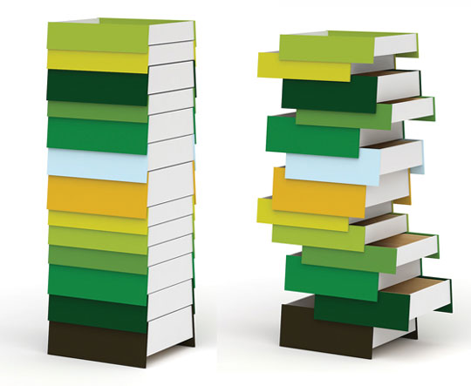
Heap and Stack

Slide 12
Memory is nothing more than a large contiguous collection of bytes, yet it must store executable code and all the different types of data used within your programs.
As a means of managing memory, most systems structure memory as follows:
Code
Static
Heap
Free memory
Stack
Executable program code
Dynamically allocated memory (new/delete)
Automatic variables (local variables, function parameters)
Storage of global and static variables

Slide 13

Key takeaways:
Understanding how your data is stored and arranged in memory is key to writing efficient programs.
In C++ this comes down to understanding heap and stack storage alongside variable scope and linkage.
Your understanding of how data is stored will be important when we explore dynamic memory allocation and pointers in C++.

